Slide 1
Markov Decision Processes

Slide 2
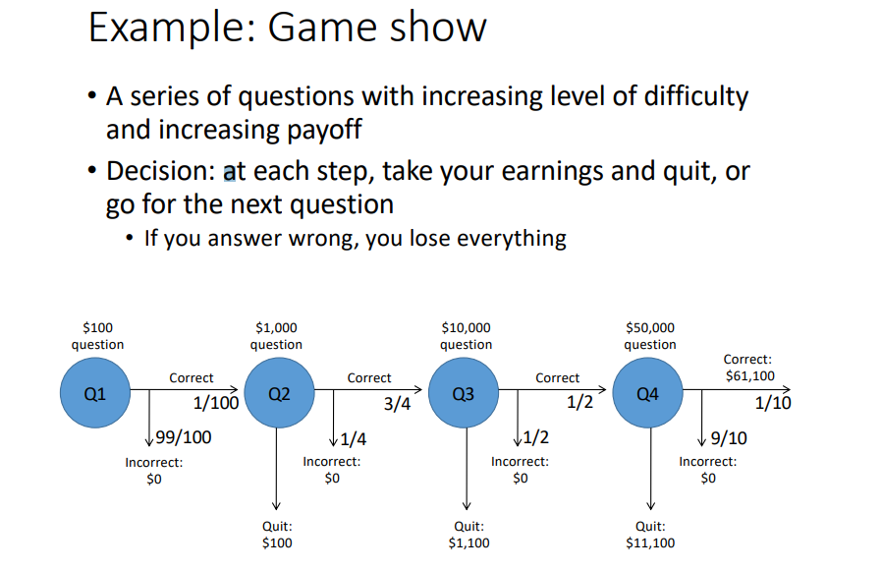

Slide 3
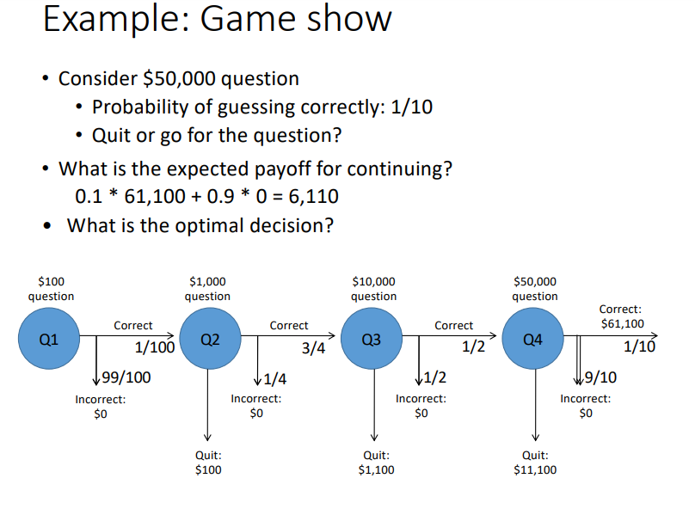

Slide 4
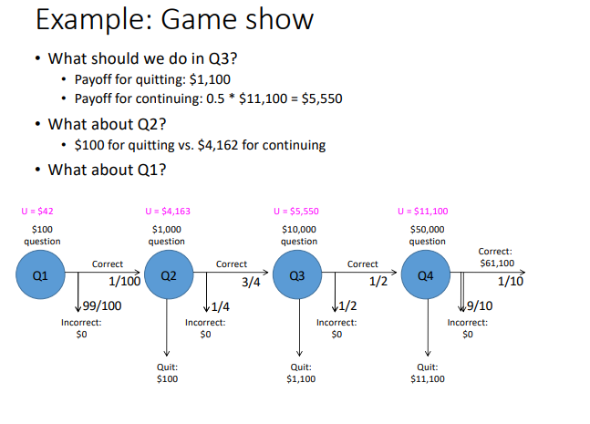
Can we do this using any method Study till now?

Slide 5
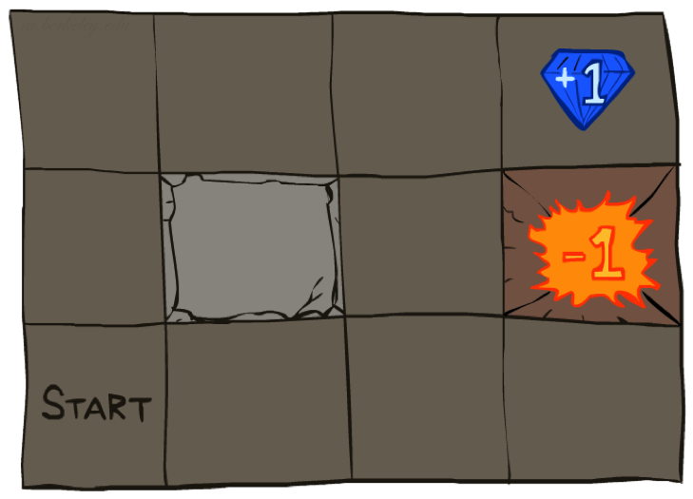




Example: Grid World
A maze-like problem
The agent lives in a grid
Walls block the agent’s path
Noisy movement: actions do not always go as planned
80% of the time, the action North, takes the agent North . (if there is no wall there)
10% of the time, North takes the agent West; 10% East
If there is a wall in the direction the agent would have been taken, the agent stays put
The agent receives rewards each time step ( how it is different from Search formulation ?)
Reward depends on agent’s state and action
Can be positive, zero or negative
Goal: maximize sum of rewards
Notes:
[cut demo of moving around in grid world program]

Slide 6
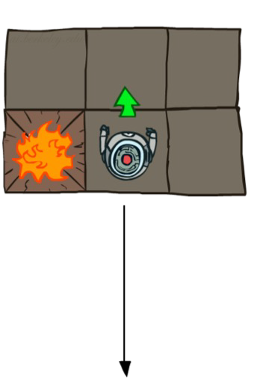
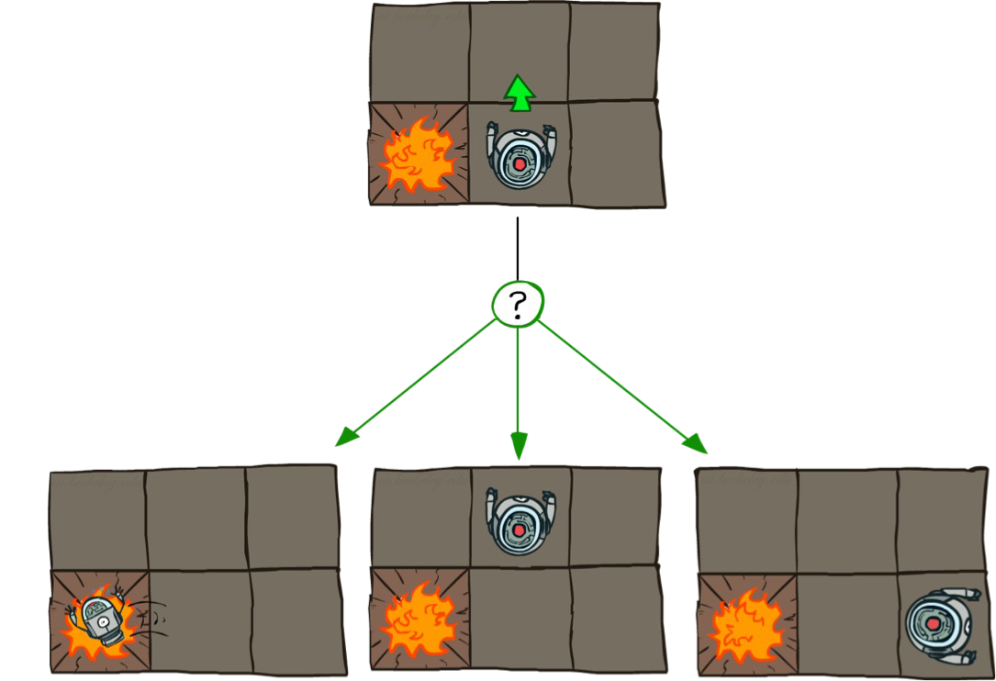
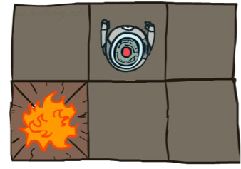
Grid World Actions
Deterministic Grid World
Stochastic Grid World
0.1
0.1
0.8

Slide 7
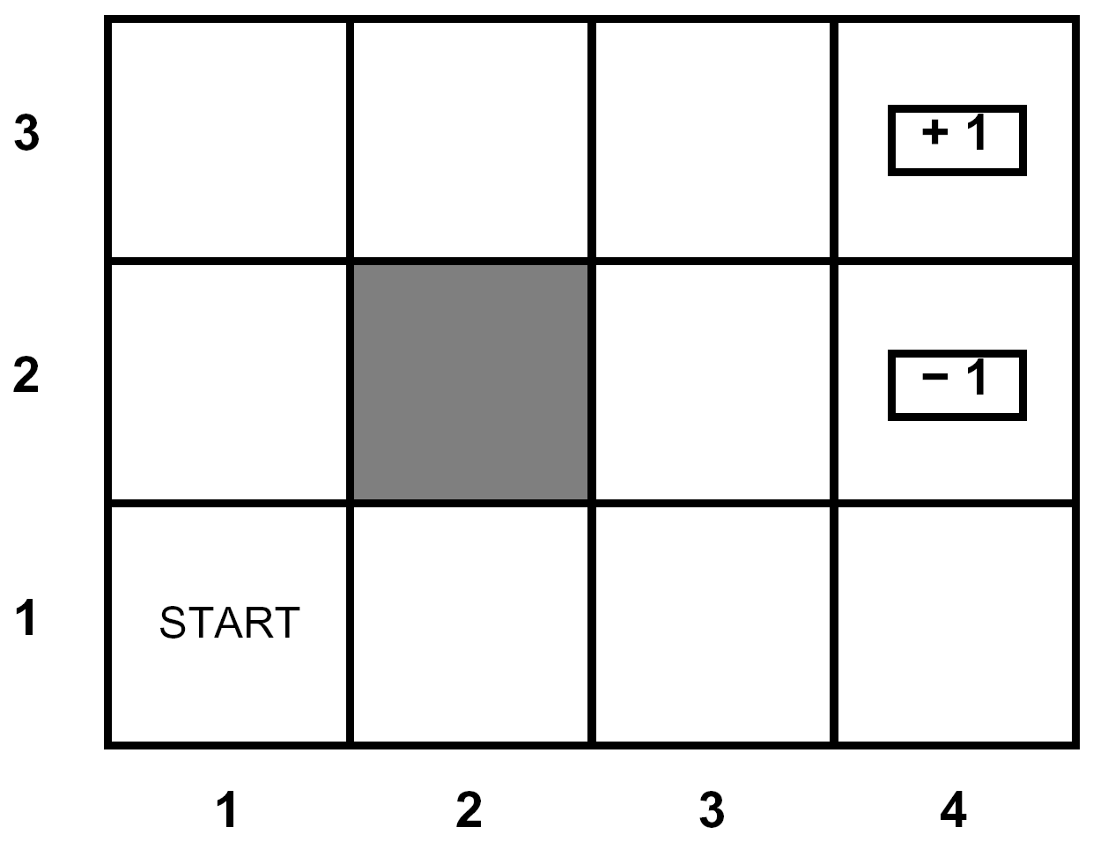
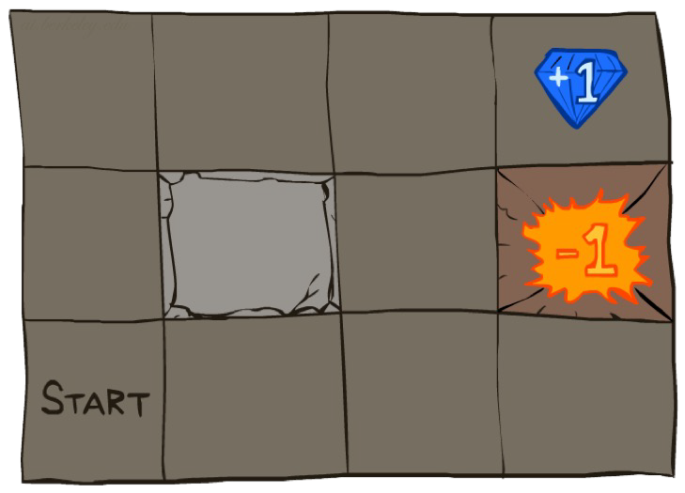




Markov Decision Processes
An MDP is defined by:
A set of states s ∈ S
A set of actions a ∈ A
A transition function T(s, a, s’)
Probability that a from s leads to s’, i.e., P(s’| s, a)
Also called the model or the dynamics
A reward function R(s, a, s’)
Sometimes just R(s) or R(s’)
MDPs are modeled with small "living" rewards at each step to reward an agent’s survival
along with large rewards for arriving at a terminal state
A start state
Possible one or more terminal state

Slide 8
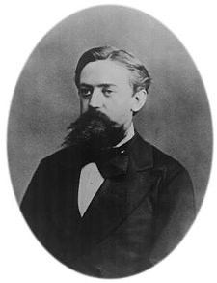

What is Markov about MDPs?
“Markov” generally means that given the present state, the future and the past are independent
For Markov decision processes, “Markov” means action outcomes depend only on the current state
Andrey Markov (1856-1922)
This is just like search, where the successor function could only depend on the current state (not the history)
Ignore History

Slide 9
Policies
In deterministic single-agent search problems, we wanted an optimal plan, or sequence of actions, from start to a goal
For MDPs, we want an optimal policy π*: S → A
A policy π gives an action for each state
An optimal policy is one that maximizes expected utility if followed
Expectimax didn’t compute entire policies
It computed the action for a single state only

Slide 10
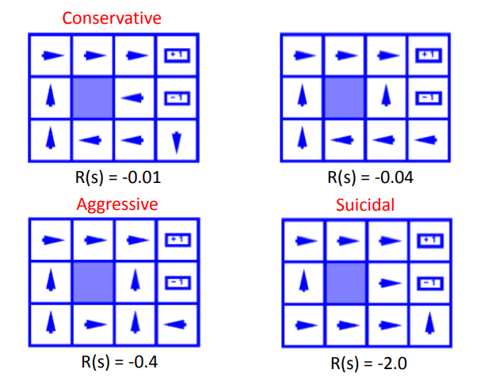


Optimal Policies

Slide 11
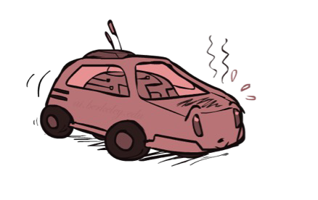
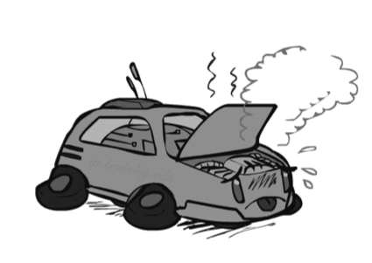
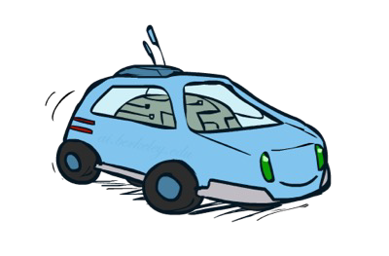
Example: Racing
Just like in a state-space graph, each of the three states is represented by a node, with edges representing actions.
For nondeterministic actions, there are multiple edges representing the same action from the same state with differing successor states
A robot car wants to travel far, quickly
Three states: Cool, Warm, Overheated
Two actions: Slow, Fast
Going faster gets double reward
+1
0.5
+1
1.0
Fast
Slow
-10
0.5
Warm
Slow
Fast
0.5 +2
Cool
0.5
Overheated
+1
1.0
+2
π*(Cool) = Fast
π*(Warm) = Slow
π*(Overheated) = end
Optimal Policy:
How could we have discovered this optimal policy ?

Slide 12
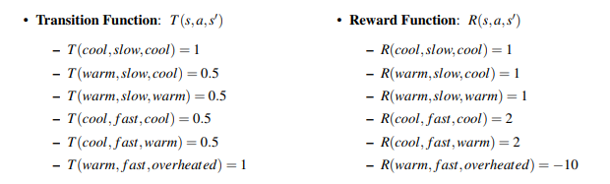

Example: Racing
We represent the movement of an agent through different MDP states over time with discrete timesteps, defining s_{t} ∈ S and a_{t} ∈ A as the state in which an agent exists and the action which an agent takes at timestep t respectively.
The movement of an agent through a MDP can thus be modeled as follows:
An agent’s goal is to maximize it’s reward across all timesteps

Slide 13



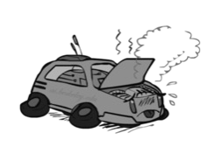
Racing Search Tree As Expectimax
. . .
. . .
. . .
. . .
. . .
. . .
. . .
. . .

Slide 14
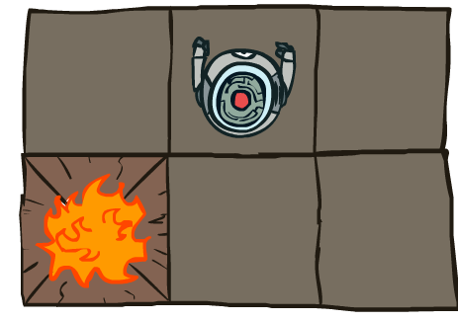
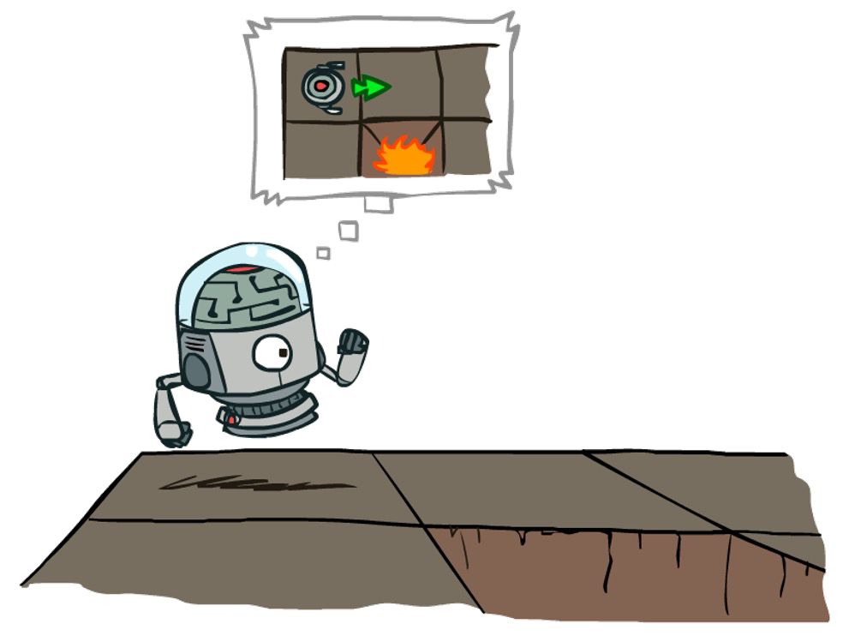
MDP Search Trees
Each MDP state projects an expectimax-like search tree
s
s is a state
a
(s, a) is a
q-state
s, a
(s,a,s’) called a transition
T(s,a,s’) = P(s’|s,a) R(s,a,s’)
T(s,a,s’)
Uncertainty is modeled in these search trees with Q-states, also known as action states, essentially identical to expectimax chance nodes.
s’

Slide 15
Utilities of Sequences
What preferences should an agent have over reward sequences?
More or less?
[1, 2, 2] or [2, 3, 4]
[0, 0, 1] or [1, 0, 0]
Now or later?

Slide 16




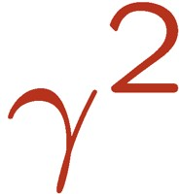

Discounting
Inherent problem with our Racecar MDP - haven’t placed any time constraints on the number of timesteps for which a racecar can take actions and collect rewards.
With our current formulation, it could routinely choose a = slow at every timestep forever, safely and effectively obtaining infinite reward without any risk of overheating.
One solution: values of rewards decay exponentially
Worth Now
Worth Next Step
Worth In Two Steps
0.8
0.64

Slide 17
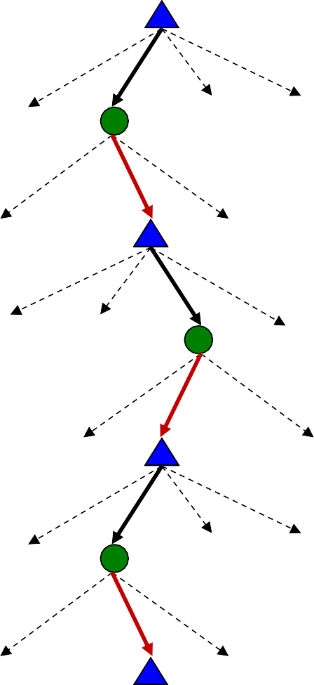

Discounting
How to discount?
Each time we descend a level, we multiply in the discount once
Example: discount of 0.5
U([1,2,3]) = 1*1 + 0.5*2 + 0.25*3 = 2.75
U([3,2,1]) = 1*3 + 0.5*2 + 0.25*1 = 5.25
U([1,2,3]) < U([3,2,1])
Prefer larger rewards earlier on.

Slide 18


Discounting
Given:
Actions: East, West, and Exit (only available in exit states a, e)
Transitions: deterministic
Quiz 1: For γ = 1, what is the optimal policy?
Quiz 2: For γ = 0.1, what is the optimal policy?
Sooner is better

Slide 19
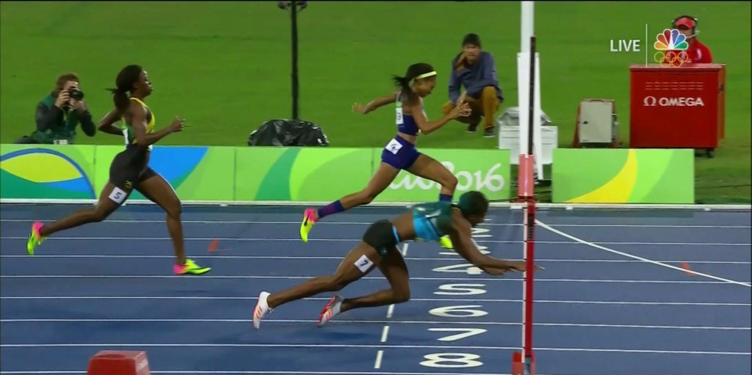
Infinite Utilities?!
Problem: What if the game lasts forever? Do we get infinite rewards?
Solutions:
Finite horizon: (similar to depth-limited search)
Terminate episodes after a fixed T steps (e.g. life)
Gives nonstationary policies (π depends on time left)
Shaunae Miller wins 400m gold medal in 2016 Olympics [Photo credit: NBC]

Slide 20
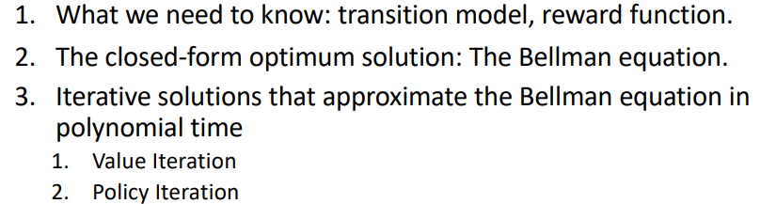
Recap: Defining MDPs
Markov decision processes:
Set of states S
Start state s₀
Set of actions A
Transitions P(s’|s,a) (or T(s,a,s’))
Rewards R(s,a,s’) (and discount γ)
MDP quantities so far:
Policy = Choice of action for each state
Utility = sum of (discounted) rewards
s
a s, a
s,a,s’
s’
To solve MDP what we need

Slide 21
Recall: Racing
A robot car wants to travel far, quickly
Three states: Cool, Warm, Overheated
Two actions: Slow, Fast
Going faster gets double reward
+1
0.5
+1
1.0
Fast
Slow
-10
0.5
Warm
Slow
Fast
0.5 +2
Cool
0.5
Overheated
+1
1.0
+2

Slide 22
Optimal Quantities
The value (utility) of a state s:
V*(s) = expected utility starting in s and acting optimally
V*(s)
s is a state
s
a
(s, a) is a q- state
The value (utility) of a q-state (s,a):
Q*(s,a) = expected utility starting out having taken action a from state s and (thereafter) acting optimally
Q*(s,a)
s, a
T(s,a,s)’
(s,a,s’) is a
transition
s’
The optimal policy:
π*(s) = optimal action from state s

Slide 23
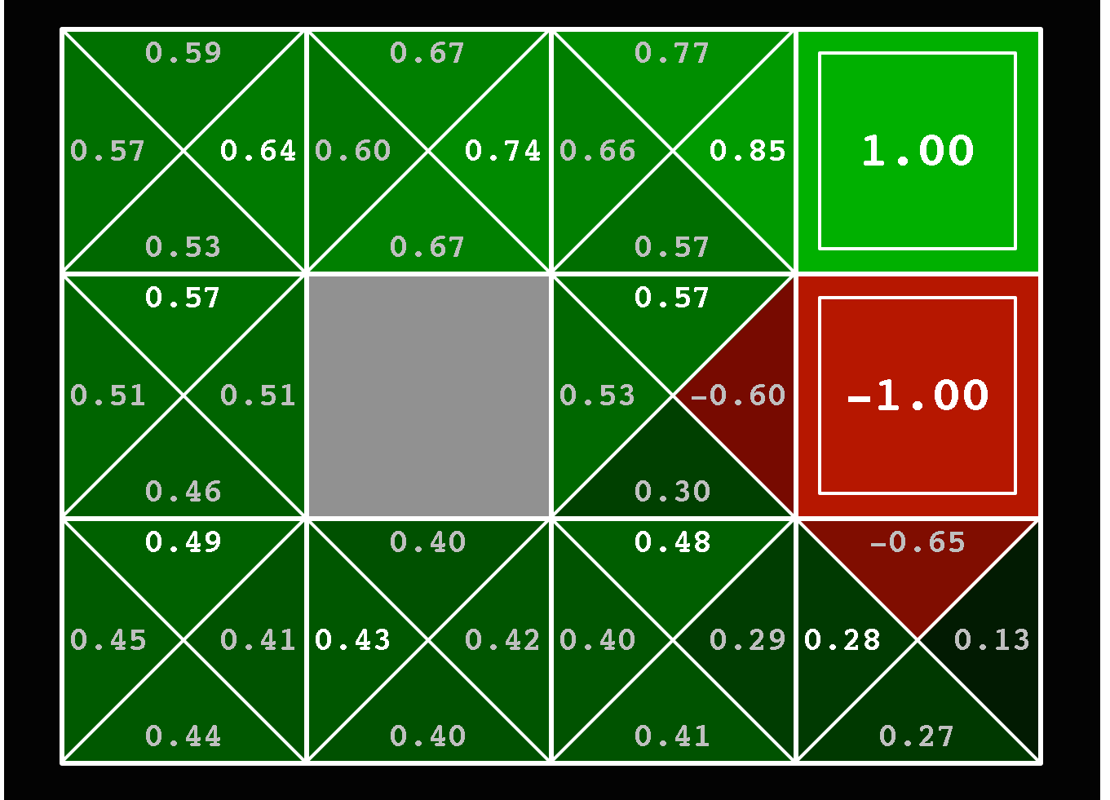
Optimal Quantities
The value (utility) of a state s:
V*(s) = expected utility starting in s and acting optimally
The value (utility) of a q-state (s,a):
Q*(s,a) = expected utility starting out having taken action a from state s and (thereafter) acting optimally
The optimal policy:
π*(s) = optimal action from state s
Here Q*(s,a) is a lookup table with 9*4+2 entries

Slide 24
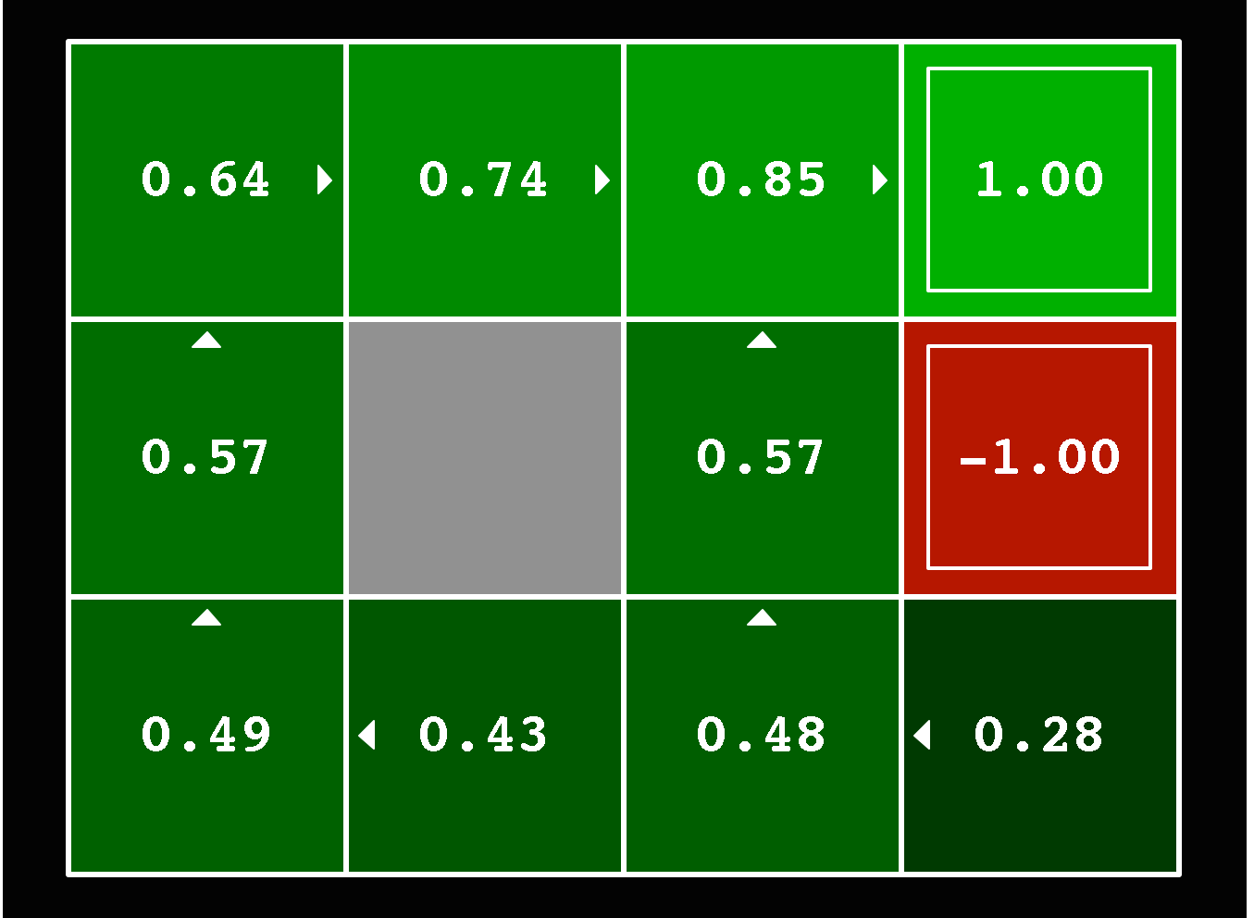
Optimal Quantities
The value (utility) of a state s:
V*(s) = expected utility starting in s and acting optimally
The value (utility) of a q-state (s,a):
Q*(s,a) = expected utility starting out having taken action a from state s and (thereafter) acting optimally
The optimal policy:
π*(s) = optimal action from state s
Here π*(s) is a lookup table with 11 entries

Slide 25


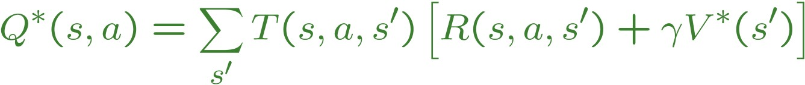
Recursive relationship between the utilities of successive states:
How to find this value V in the Expectimax search
Question: If you have Q*, how to get V*?
V*(s)
s
s is a
state
Question: If you have V*, how to get Q*?
a
(s, a) is a
q-state
Q*(s,a)
s, a
T(s,a,s’)
s’
(s,a,s’) is a
transition
V*(s’)

Slide 26
Value Iteration
Start with V₀(s) = 0:
Given vector of V_{k}(s) values, do one step of expectimax from each state:
V_{k+1}(s)
a s, a
Repeat until convergence, which yields V*
s,a,s’
V_{k}(s’)
Theorem: will converge to unique optimal values
Basic idea: approximations get refined towards optimal values

Slide 27
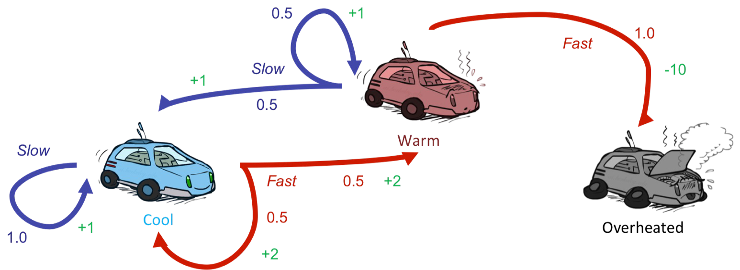


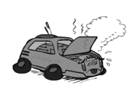
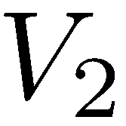
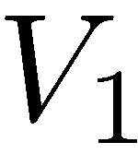
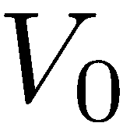
Example: Value Iteration
Assume no discount!
0
0
0

Slide 28
Example: Value Iteration
?
Assume no discount!
0
0
0
a=slow:
1(1 + 0) = 1
a=fast:
0.5(2 + 0) + 0.5(2 + 0) = 2

Slide 29
Example: Value Iteration
2
?
Assume no discount!
0
0
0
a=slow:
0.5(1 + 0) + 0.5(1 + 0) = 1
a=fast:
1(-10 + 0) = -10

Slide 30
Example: Value Iteration
?
2
1
0
Assume no discount!
0
0
0
a=slow:
1(1 + 2) = 3
a=fast:
0.5(2 + 2) + 0.5(2 + 1) = 3.5

Slide 31
Example: Value Iteration
3.5
?
0
2
1
0
Assume no discount!
0
0
0
a=slow:
0.5(1 + 2) + 0.5(1 + 1) = 2.5
a=fast:
1(-10 + 0) = -10

Slide 32
Example: Value Iteration
3.5 | 2.5 | 0
2 | 1 | 0
0 | 0 | 0
Assume no discount!

Slide 33
Value Iteration
Bellman equations characterize the optimal values:
V(s)
a s, a
T(s,a,s’)
V(s’)
Value iteration computes them:
Value iteration is just a fixed point solution method
There may be other methods to solve this Bellman equation

Slide 34
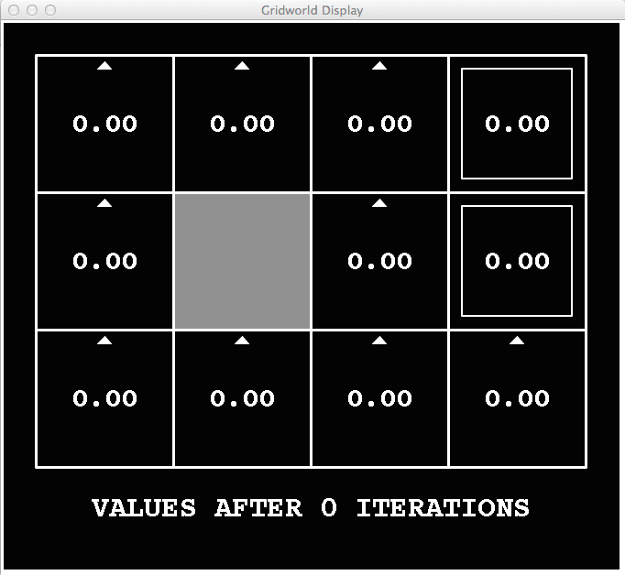
k=0
Noise = 0.2
Discount = 0.9
Living reward = 0

Slide 35
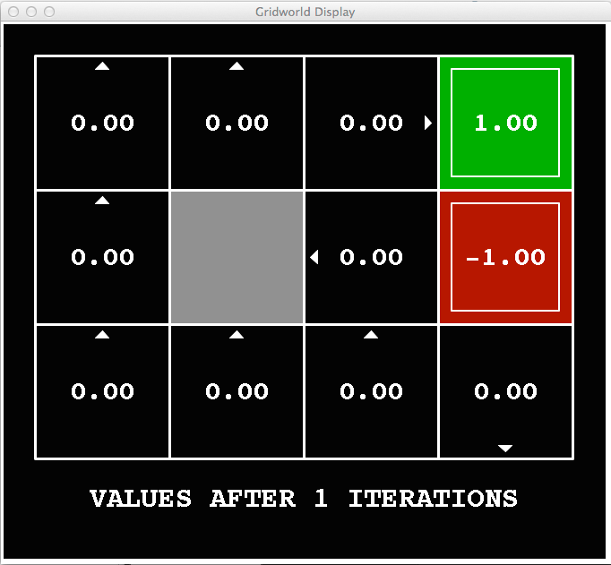
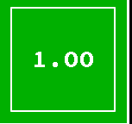
k=1
V₁(
)
V₁(s) is value of depth-1 expectimax from s

Slide 36
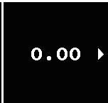
k=1
V₁(
)
V₁(s) is value of depth-1 expectimax from s

Slide 37
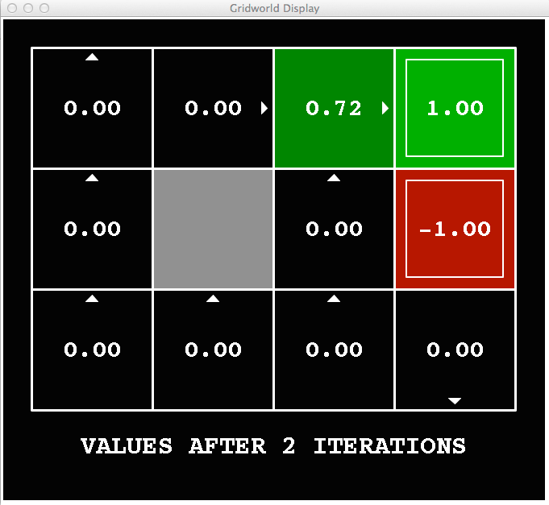
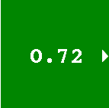
k=2
V₂(
)
V₂(s) is value of depth-2 expectimax from s

Slide 38
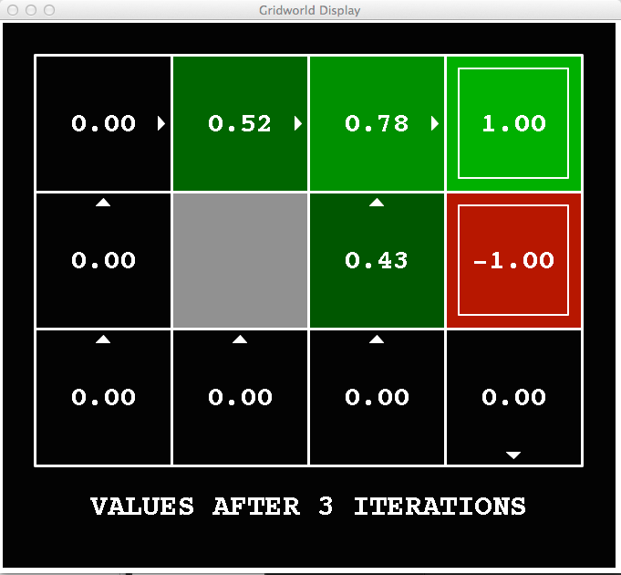
k=3
Noise = 0.2
Discount = 0.9
Living reward = 0

Slide 39
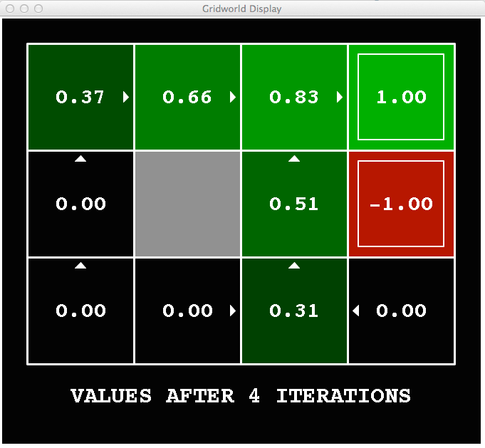
k=4
Noise = 0.2
Discount = 0.9
Living reward = 0

Slide 40
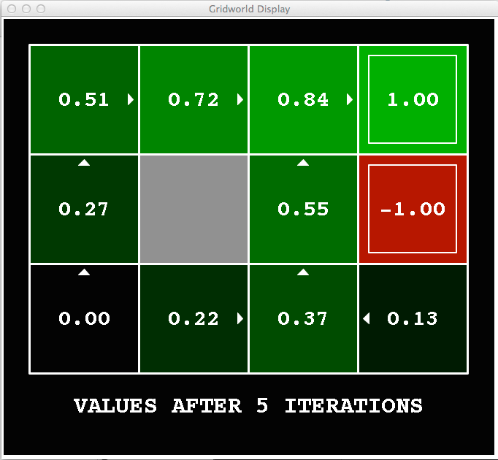
k=5
Noise = 0.2
Discount = 0.9
Living reward = 0

Slide 41
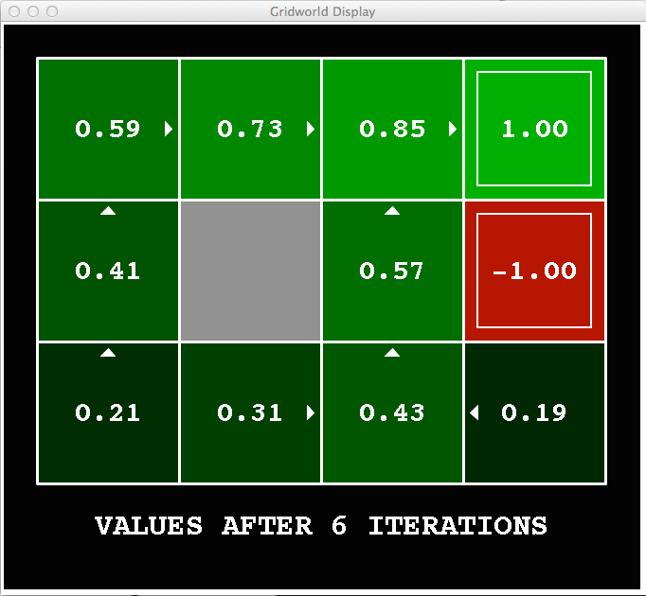
k=6
Noise = 0.2
Discount = 0.9
Living reward = 0

Slide 42
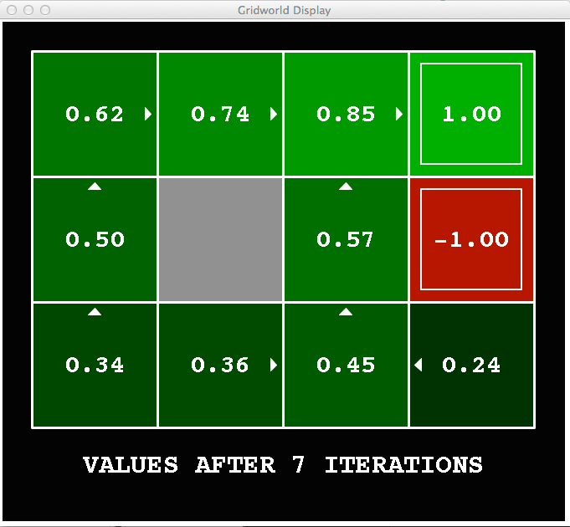
k=7
Noise = 0.2
Discount = 0.9
Living reward = 0

Slide 43
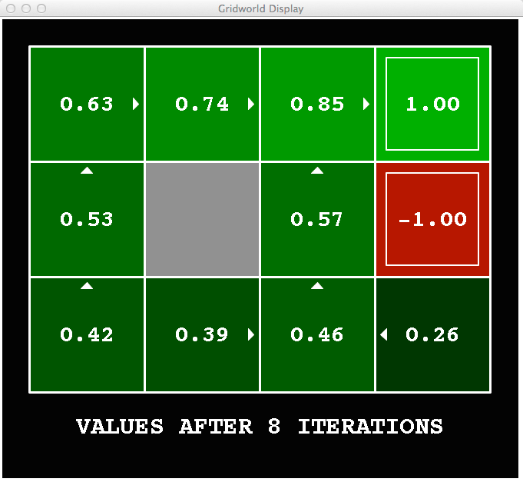
k=8
Noise = 0.2
Discount = 0.9
Living reward = 0

Slide 44

k=9
Noise = 0.2
Discount = 0.9
Living reward = 0

Slide 45
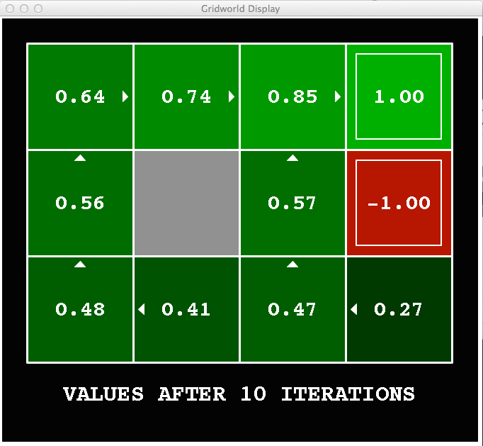
k=10
Noise = 0.2
Discount = 0.9
Living reward = 0

Slide 46
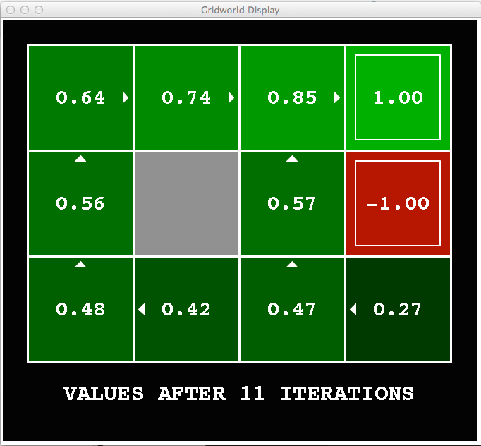
k=11
Noise = 0.2
Discount = 0.9
Living reward = 0

Slide 47

k=12
Noise = 0.2
Discount = 0.9
Living reward = 0

Slide 48
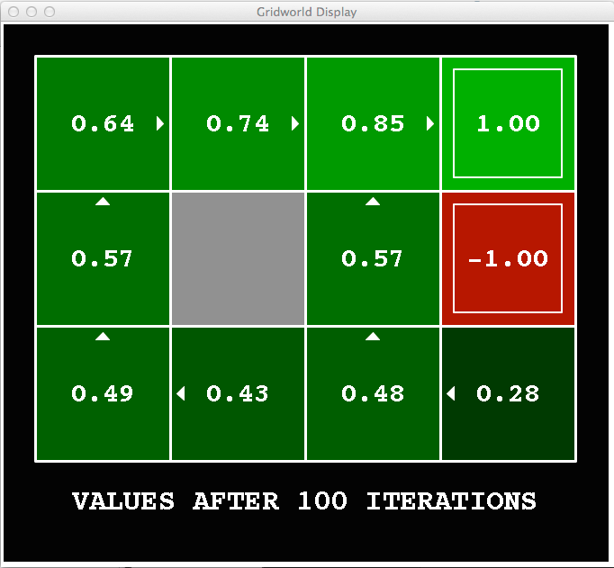
k=100
Noise = 0.2
Discount = 0.9
Living reward = 0

Slide 49
Problems with Value Iteration
Problem 2: The “max” at each state rarely changes
Problem 3: The policy often converges long before the values

Slide 50
k=12
k=100
Noise = 0.2
Discount = 0.9
Living reward = 0

Slide 51

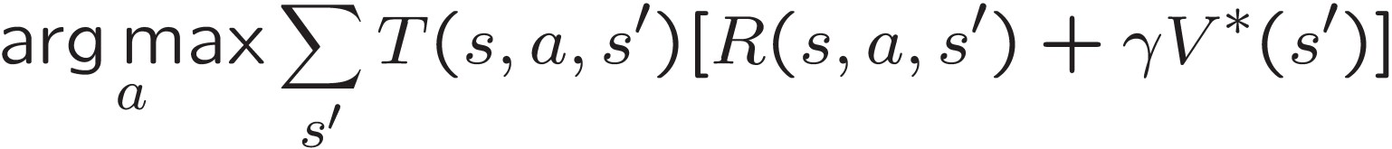
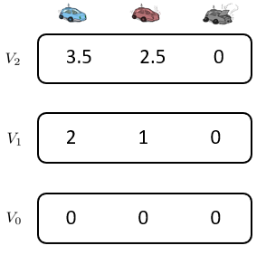
Computing Actions from Values: Policy Extraction
Question: If you have Q*, how to get π*?
Let’s imagine we have the optimal values V*(s)
ex:
max [0.5, 1.7, 1.2] = 1.7
argmax [0.5, 1.7, 1.2] = 1
This is called policy extraction, since it gets the policy implied by the values

Slide 52
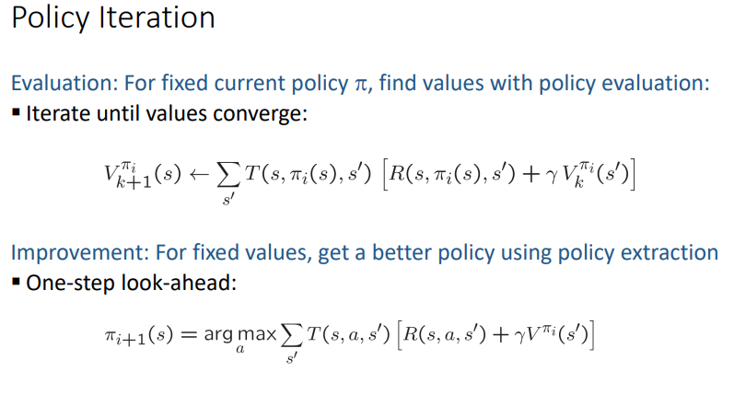

Slide 53
Fixed Policies
Do the optimal action
s
a s, a
Do what π says to do
s
π(s) s, π(s)
s,a,s’
s, π(s),s’
s’ s’
Expectimax trees max over all actions to compute the optimal values
If we fixed some policy π(s), then the tree would be simpler – only one action per state
… though the tree’s value would depend on which policy we fixed

Slide 54
Utilities for a Fixed Policy
Define the utility of a state s, under a fixed policy π:
V^{π}(s) = expected total discounted rewards starting in s and following π
s
π(s) s, π(s)
What is the recursive relation (one-step look-ahead / Bellman equation)?
Hint: recall Bellman equation for optimal policy:
s, π(s),s’
s’

Slide 55
Utilities for a Fixed Policy
Define the utility of a state s, under a fixed policy π:
V^{π}(s) = expected total discounted rewards starting in s and following π
s
π(s) s, π(s)
What is the recursive relation (one-step look-ahead / Bellman equation)?
Hint: recall Bellman equation for optimal policy:
s, π(s),s’
s’
Answer:

Slide 56

Policy Evaluation
How do we calculate the V’s for a fixed policy π?
s
π(s) s, π(s)
Idea 1: Turn recursive Bellman equations into updates (like value iteration)
s, π(s),s’
s’

Slide 57
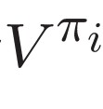
Policy Iteration
Evaluation: For fixed current policy π, find values with policy evaluation:
Iterate until values converge:
End up with value function
Improvement: For fixed values, get a better policy using policy extraction
One-step look-ahead:
Repeat steps until policy converges

Slide 58
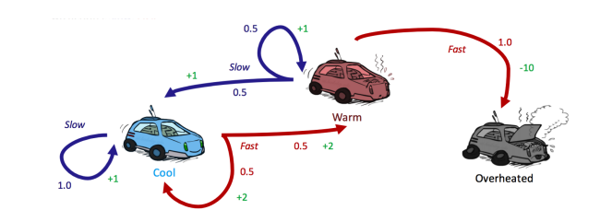


Example
The next step is to run a round of policy evaluation to find values on π₀:

Slide 59


Example
This example shows the true power of policy iteration: with only two iterations, we’ve already arrived at the optimal policy for our racecar MDP!

Slide 60
Comparison
Both value iteration and policy iteration compute the same thing (all optimal values)
In value iteration:
Every iteration updates both the values and (implicitly) the policy
We don’t track the policy, but taking the max over actions implicitly recomputes it
In policy iteration:
We do several passes that update utilities with fixed policy (each pass is fast because we consider only one action, not all of them)
After the policy is evaluated, a new policy is chosen (slow like a value iteration pass)
The new policy will be better (or we’re done)
Both are dynamic programs for solving MDPs

Slide 61
Summary: MDP Algorithms
So you want to….
Compute optimal values: use value iteration or policy iteration
Value Iteration or Policy Iteration
V* V*
Compute values for a particular policy: use policy evaluation
Policy Evaluation
_{V}π
π
Turn your values into a policy: use policy extraction (one-step lookahead)
Policy Extraction
_{π}V
V

Slide 62
Summary: MDP Algorithms
So you want to….
Compute optimal values: use value iteration or policy iteration
Compute values for a particular policy: use policy evaluation
Turn your values into a policy: use policy extraction (one-step lookahead)
These all look the same!
They basically are – they are all variations of Bellman updates
They all use one-step lookahead expectimax fragments
They differ only in whether we plug in a fixed policy or max over actions

Slide 63


Summary: Bellman Equation Zoo!
Optimal V and Q value functions:
Value function for fixed policy π:
Policy π for V and Q value functions:

Slide 64
The Bellman Equations
How to be optimal:
Step 1: Take correct first action Step 2: Keep being optimal
“Journey of a thousand optimal steps begins with a first optimal step”

